Slide 1
Needle in the Haystack
The Search for Truth in the 21st Century
Notes:
Intended Audience: The University of California Berkeley Research Leadership Team
Team: Andrew Miller, Gauri Ganjoo, Jacquie Nesbitt, John-Michael Stilb
Good evening and thank you to the UC Berkeley Research Leadership Team for joining us.
Tonight we will be discussing the dangers of misinformation and our proposal to study what we believe to be a key and relatively unexplored component contributing to the so-labeled information epidemic..

Slide 2
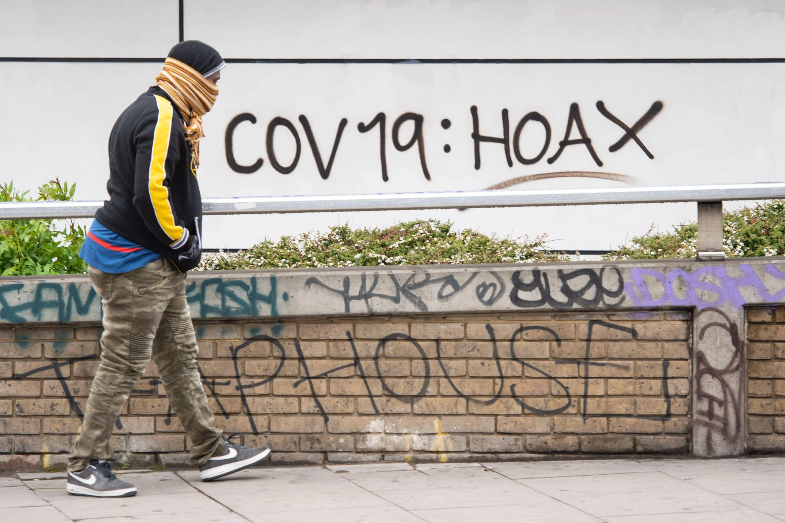
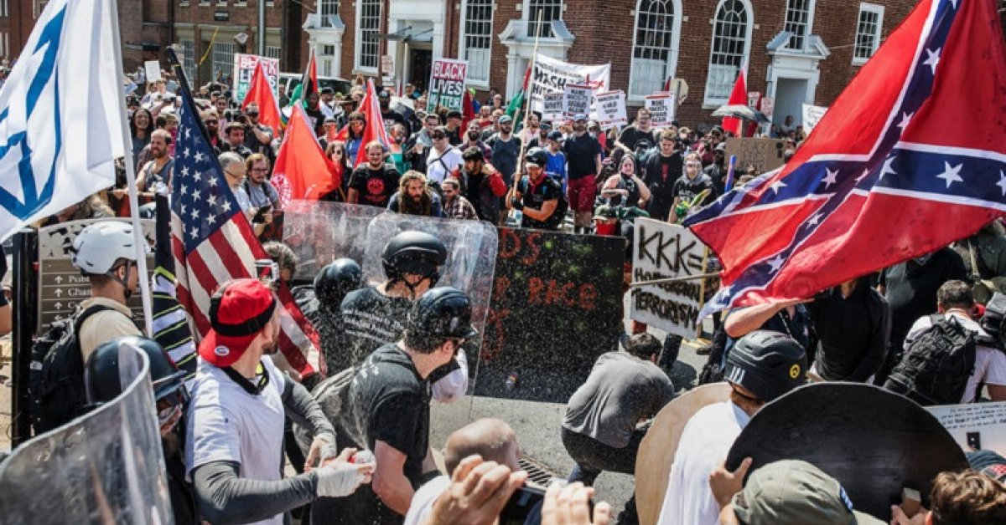
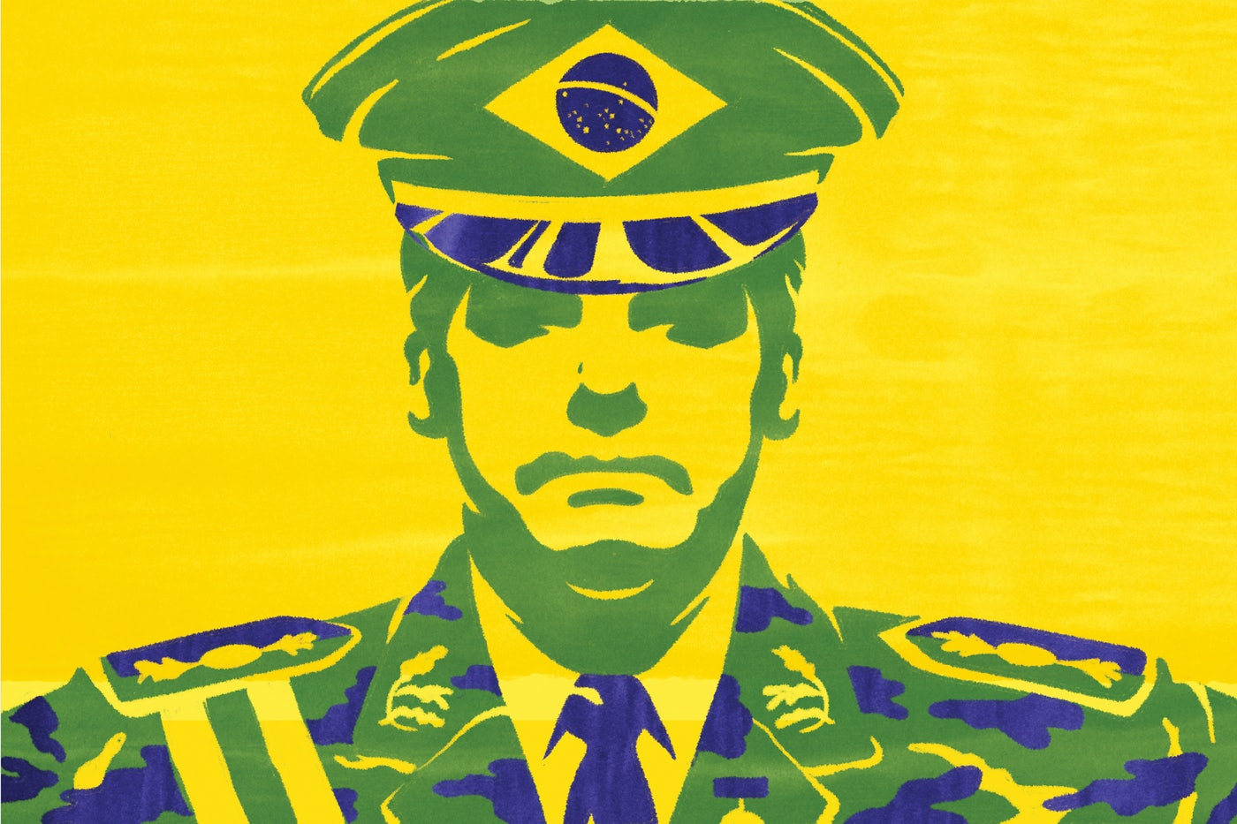
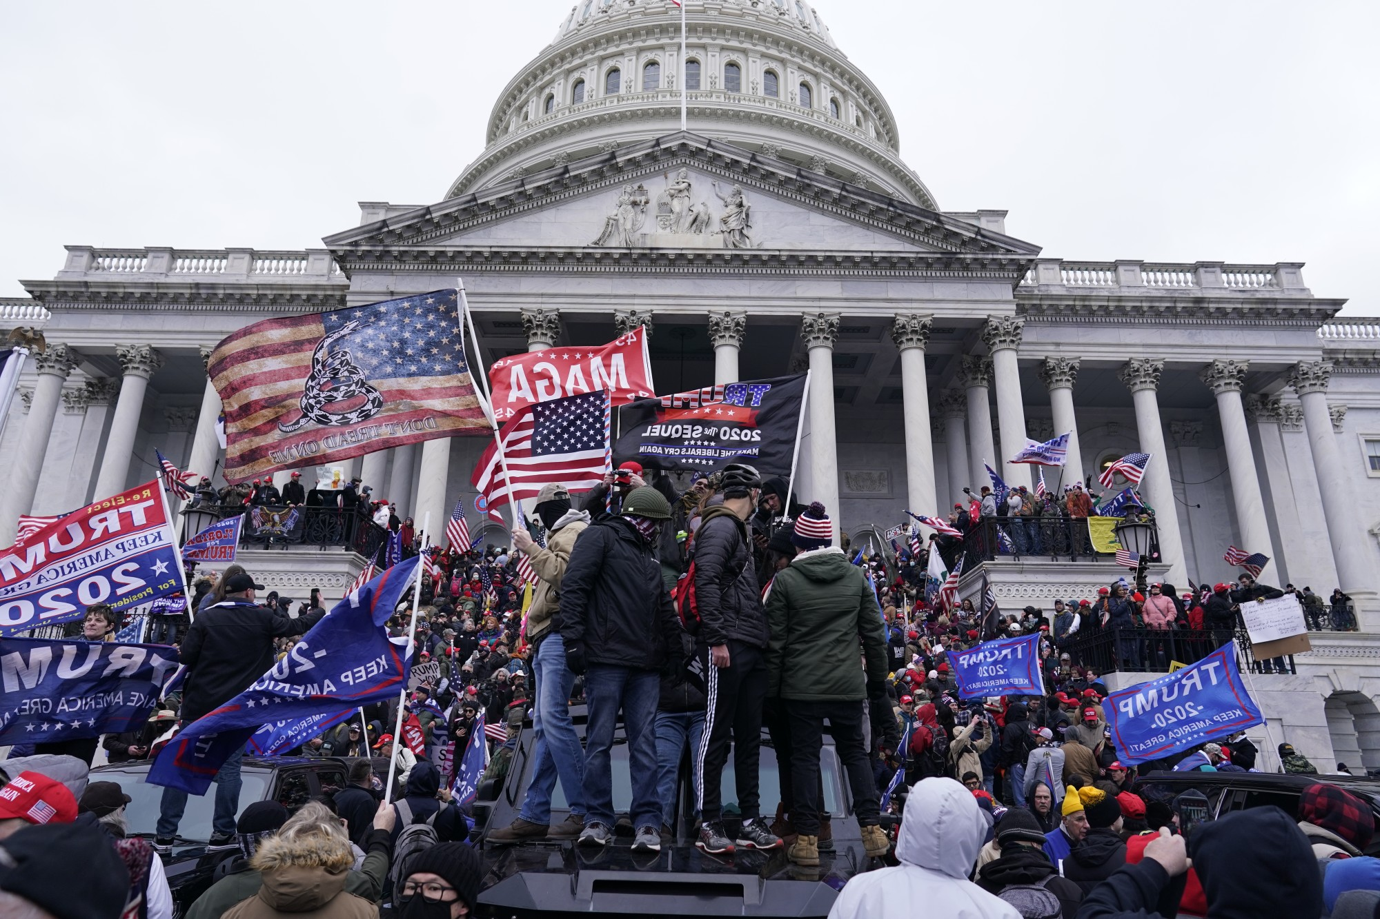
Problem
Notes:
Misinformation has pervaded and corrupted societies across the globe.
It has contributed to political division, rising authoritarianism, a fatal mistrust in science, and domestic terrorism.

Slide 3
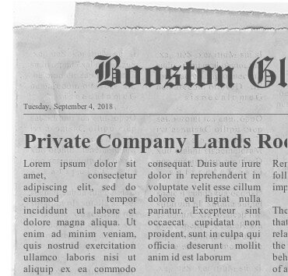
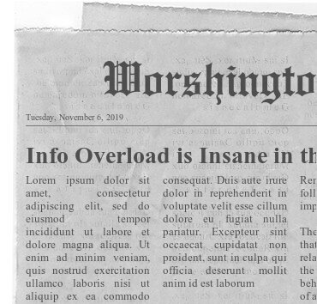
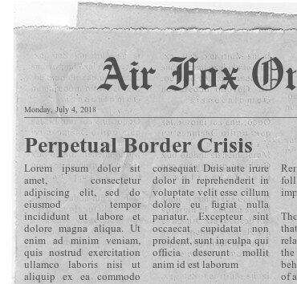
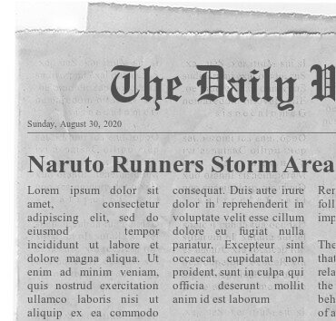
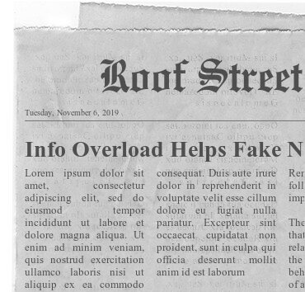
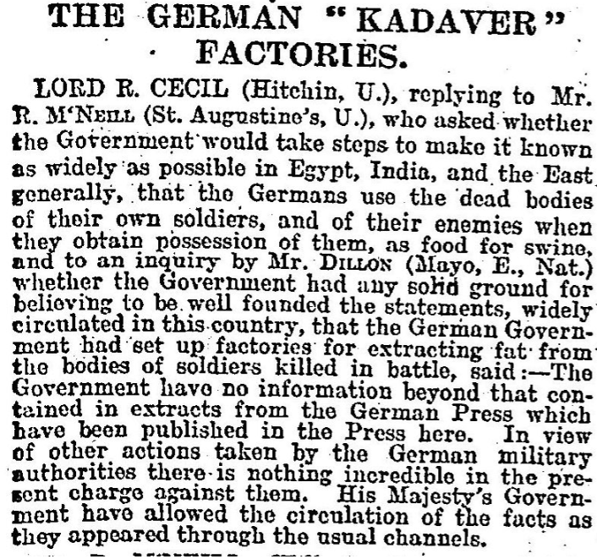
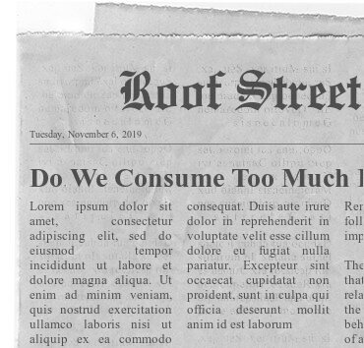
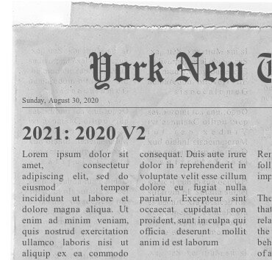
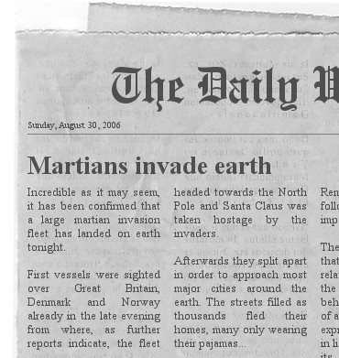
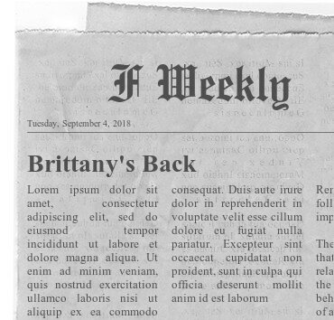
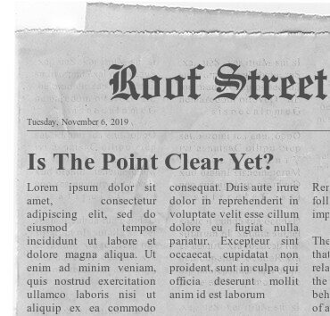
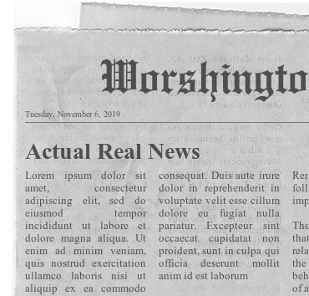
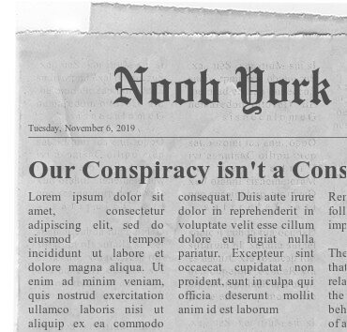
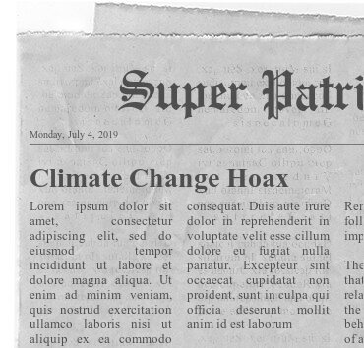
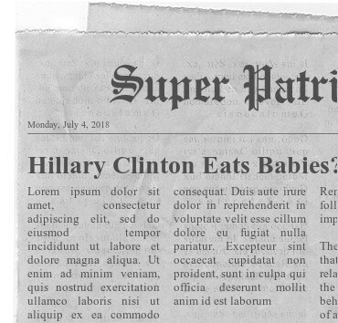
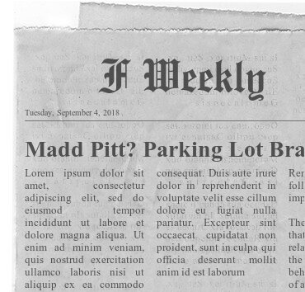
Problem
Notes:
However, misinformation is nothing new as evidenced by this WW1 propaganda poster that you probably aren’t certain I just made up.
What is new, however, is the abundance of information we consume and share daily. In 2019, Americans spent—on average—over 12 hours a day consuming traditional and digital media.
Just as computers face processing limitations, so does the human mind; and we believe the inundation of information is negatively affecting people’s ability to identify fake news and thus contributing to the dissemination of misinformation.

Slide 4











Research Question
Notes:
So we have designed a study to answer the question: Will reducing an individual’s time spent consuming information improve their ability to correctly classify fake and non-fake news?
Our hope is that our findings demonstrate a clear link between quantity of media consumption and resilience to misinformation to drive further research and application.
In this study, we will test current University of California at Berkeley students’ ability to correctly classify fake/non-fake news.
We will increasingly limit several of the groups desktop and mobile usage over the span of 4 weeks via an application called Freedom to see whether those who are spending less time consuming information are more adept at correctly classifying it.
Now to talk more in-depth about our experiment design...Jacquie

Slide 5

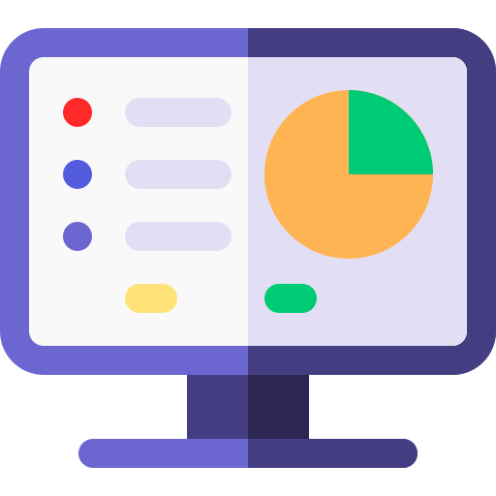
Study Design: Phase 1 - Monitoring
Notes:
We will conduct this study in two phases.
In phase 1, all participants will also fill out a short online survey asking general demographics, including their year and field of study. Additionally, All participants are monitored via the Freedom app for a week without any time or content restrictions. We intend to gather baseline information about the participant’s information consumption habits, like how long they typically spend looking at social media, news sites and other information outlets.
Image Credit:
https://www.flaticon.com/authors/freepik

Slide 6



Study Design: Phase 2 - Experiment
“I’m not sure.”
Notes:
In phase two, which is the experiment phase will take 1 month and consist of 2 control groups and 2 experiment groups. Our control group will continue without any time or content restrictions like in the monitoring phase for the month, however, our experiment groups will have their time restricted daily in the first week to 80% of their baseline, the second to week to 60% of their baseline, the third week to 40% of their baseline, and the fourth week to 20% of their baseline. Throughout each week, the control and experiment groups will be asked to complete a short activity. During the activity the participants will access a site that we curate where they will interact with three randomly assigned articles composed of fake and non-fake news according to Snopes. Each article will be sanitized so that only the textual content will be available for review to prevent participants from judging an article’s factuality based upon aesthetics, source notoriety or party association. Once clicking an article the participant will have 5 minutes to read the article before being asked if they believe the article contained misleading and/or inaccurate information in a yes or no fashion. Except, control group 2 and experiment group 2 will slightly deviate because they will have 3 choices: yes, no, and I’m not sure. We’ve included this additional treatment group in an effort to gain insight into participants’ certainty when it comes to classifying fake and non-fake news.
Lastly, at the conclusion of the experiment, each participant will receive an email listing the different articles they read, Snopes fake news assessment, and what in the article was misleading and/or inaccurate information when appropriate so that as researchers we are not contributing to the spread misinformation with this study. And with that I am going to turn it over to Andrew who is going to speak about our sample. Andrew?
Image Credit:
https://www.flaticon.com/authors/freepik

Slide 7
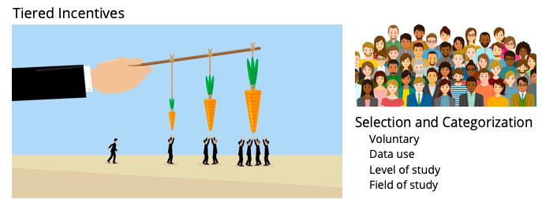
Sample
Notes:
Our sampling frame includes students currently enrolled in UC Berkeley in a degree-conferring program of study, who volunteer for participation. An average internet-accessed media consumption of at least two hours daily, and personal electronic device compatibility with the Freedom application are required for inclusion.
We are requesting sufficient resources to offer scaling incentives for participants that increase the longer a participant remains compliant with the study. We will also use UC Berkeley sponsored media and distros to advertise for participation.
Participants will be categorized according to their academic level of study (Graduate/Undergraduate) as well as the field of study of their declared or expected major (humanities, social sciences, natural sciences, formal sciences, and applied sciences.).
Using quota sampling, we will strive for at least 40 and no more than 60 students from each of the ten categories who will be randomly and equally distributed between the four experiment/control groups. This will give us a total sample size between 400 and 600 students, ensuring that our proposed incentive is not prohibitively expensive while also achieving a minimum overall sample size as prescribed by available sample size calculators (http://www.raosoft.com/samplesize.html).
Image references:
https://www.swoopanalytics.com/blog/how-many-groups
https://www.bravon.io/incentives-vs-gamification/

Slide 8
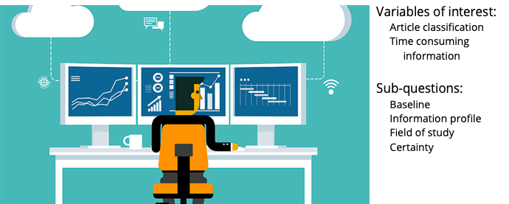
Analysis
Notes:
Our dependent and independent variables of interest are performance on our test articles, and time spent consuming information online, respectively. Performance on article classification will be evaluated with standard analytic methods (accuracy, precision, recall, and F1 score).
By our method of sampling, we also hope to gain insight into other potential factors associated with our hypothesized relationship. Namely, we will examine baseline performance vs. consumption time prior to intervention, the effect of one’s information profile (percentage of traditional news vs. social media), and any effect of one’s field of study. By allowing an “I don’t know” option to select groups, we will also examine how the treatment impacts participants’ certainty of their answers.
The purpose of this research is exploratory, and thus our sampling and analysis are not intended to extrapolate to any population beyond our sample, nor is it intended to reflect how well these participants may classify news articles outside of this experimental setting. Variables that may impact an individual’s ability to classify fake/non-fake news in normal settings (news source information, political leanings of the individual and article, etc.) are therefore not considered in this study. We are examining any effect our treatment may have on their article classification performance, and how our identified sub-questions may impact that relationship.
And with that, I’m going to turn it over to Gauri who will talk about our project’s deliverables. Gauri?
Image references:
https://research.phoenix.edu/blog/selecting-right-statistical-analysis-tool-your-research

Slide 9

Deliverables
Notes:
Now we’ll talk about the timeline for the project. It will take us about a month to gather all the participants. After the institutional review board process is done, we could formally start the experiment in June 2022 and be done by the beginning of July. It will take us another month and a half to analyze our findings and do a formal write-up with next-step recommendations for the research. We plan to be able to present our results at data conferences by the end of September.
Image reference:
https://www.istockphoto.com/search/2/image?mediatype=illustration&page=2&phrase=workplace%20vector

Slide 10

Potential Risks
Notes:
We have 3 main potential risks we would like to talk about. The first is if participants choose to consume media on a third party device that we cannot track such as a library computer. We will try to discourage this in participants as best we can but there is an element of uncertainty. The second is if participants quit the experiment early because they consider the length of the experiment or the restrictions too tedious. We will try to mitigate this by creating incentives to stay in the experiment, but if participants still drop out, it will reduce our sample size and potentially introduce more bias into the experiment. The third are the ethics and privacy concerns for our participants. We will mitigate this by sending our proposal to an institutional review board for approval, not capturing the content the participants consume, and de-identifying all data after collection.
Image Reference:
https://www.istockphoto.com/search/2/image?mediatype=illustration&phrase=workplace%20vector%20risk

Slide 11
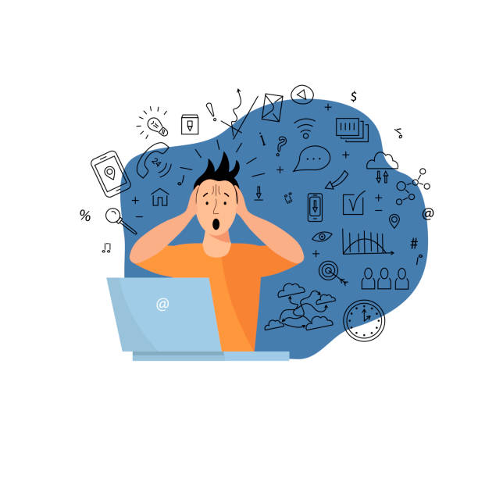
Conclusion
Notes:
Sometimes it can feel like there is more fake news available today than ever before or that we as a collective have become worse at discerning fake news from non-fake news. But whether either of those scenarios or both of those scenarios are true, we would like to see if information reduction can help address this issue that has become more and more glaring over the last decade. With our experiment, we hope to start looking into this option and hopefully be able to greenlight more experiments on this topic in the future.
Image Reference:
https://www.istockphoto.com/search/2/image?mediatype=illustration&phrase=workplace%20vector%20info%20overload

Slide 12
Image Source
https://www.adl.org/sites/default/files/styles/open_graph_image_1200_x_628_/public/2017-08/ANTIFA%20Cville%20Credit%20Edu%20Bayer%20for%20The%20New%20York%20Times%20%282%29.jpg?itok=sCHM1_Av
https://ca-times.brightspotcdn.com/dims4/default/f8f33b8/2147483647/strip/true/crop/6000x3999+0+0/resize/2000x1333!/quality/90/?url=https%3A%2F%2Fcalifornia-times-brightspot.s3.amazonaws.com%2F63%2F8f%2Fc283677a4fa3b75dafb7af2032c7%2Fla-photos-1staff-682883-na-pol-certification-protest-kkn-0214.JPG
https://images.newrepublic.com/5f4d3346393b205a584869a80af9fd72642d393c.jpeg?auto=compress&w=1400&ar=3%3A2&fit=crop&crop=faces&q=65&fm=jpg&ixlib=react-9.0.2
https://static.scientificamerican.com/sciam/cache/file/E4027069-A4E4-41E2-8E1556539BCCC03E_source.jpg
https://www.thesocialhistorian.com/wp-content/uploads/2017/05/Kadaver.jpg
https://www.fodey.com/generators/newspaper/snippet.asp
https://lh3.googleusercontent.com/proxy/3fOa4EhgB-KL8BzZjqSNOBKLp8pB8ss2lezDqPzCyBvNa9Ck7LWzhgomSN9EociNoSlXLQs1hb3w3YSQjLAktRRjHAFaYc48zDE

